Slide 1
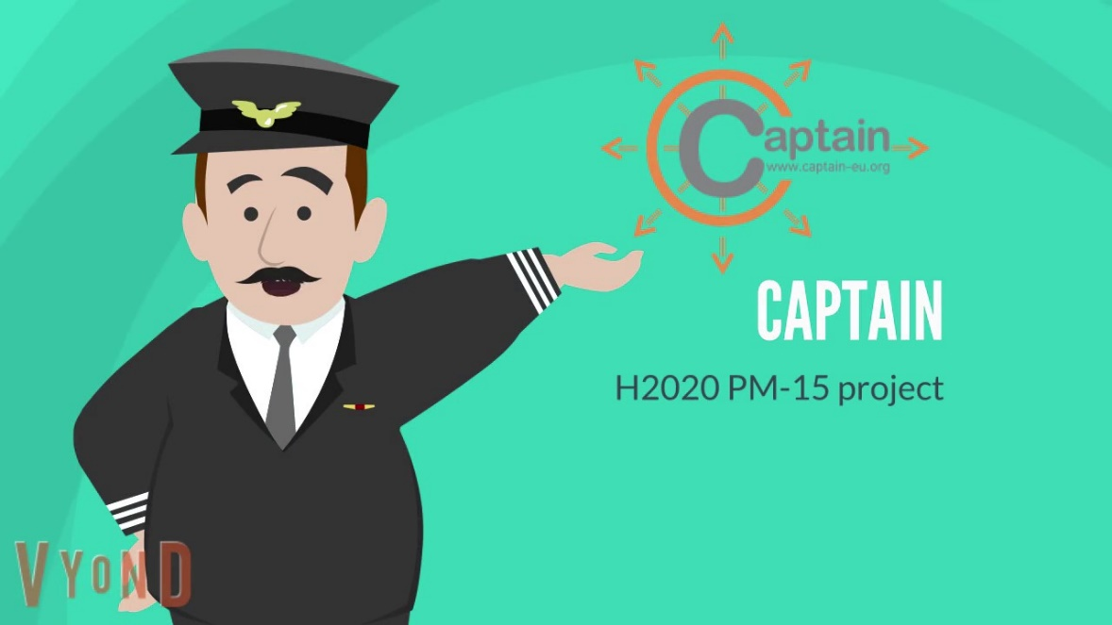
Coach Assistant via Projected and Tangible Interface

Slide 2
Introduction
Hi, I’m CAPTAIN and I’m inviting you to join me on board
CAPTAIN
European research project, based on the principles of Active & Healthy Ageing
Older adults 60+ years old) (family & formal caregivers)
Duration: Dec 2017 – Nov 2020

Slide 3
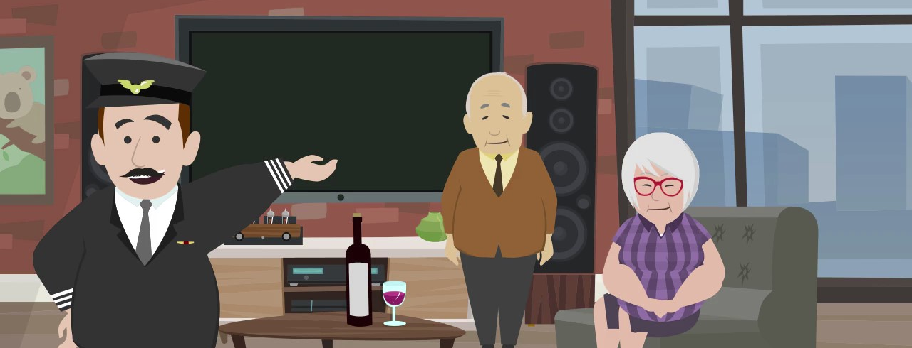
The problem
Retaining physical, cognitive and social well-being can be a challenge as we age.

Slide 4
Our mission…
…is to turn the future homes of older adults into a gentle coach

Slide 5
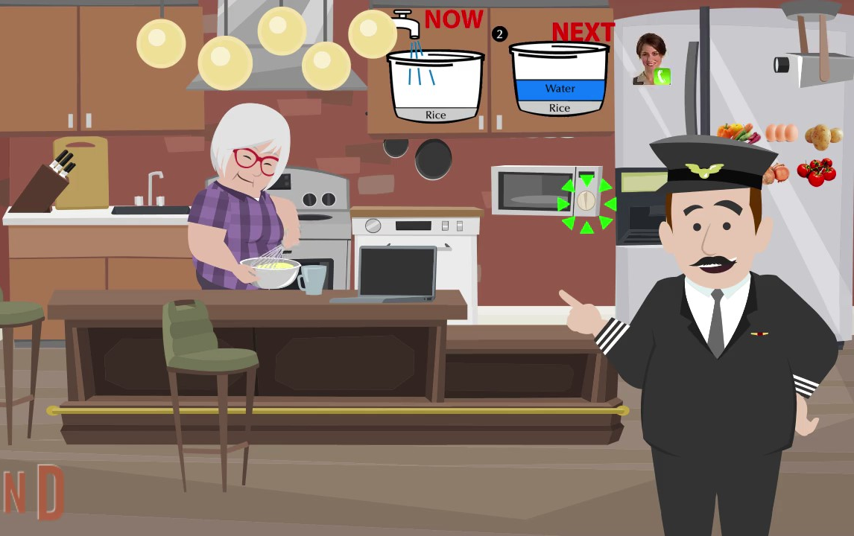
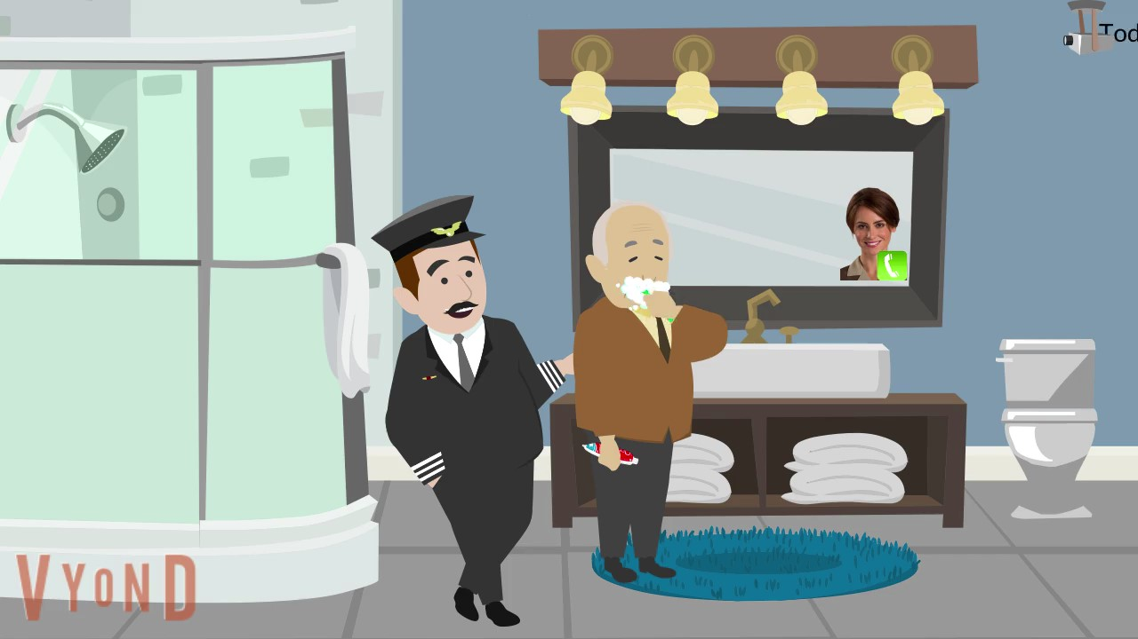
The solution
CAPTAIN will become a smart assistant whenever and wherever you want.
Today it’s your daughter’s
birthday. Call her.

Slide 6
We want to keep your home a “cozy” and welcoming place.

Slide 7
The food is ready.
Turn off the oven.
Notes:
For instance! Explain the example where the CAPTAIN system projects a reminder on the wall to inform them that the food is ready or their daily measurements of blood pressure in the table.

Slide 8
Today it’s your daughter’s
birthday. Call her.
Notes:
For instance! Explain the example where the CAPTAIN system projects a reminder on the wall to inform them that the food is ready or their daily measurements of blood pressure in the table.

Slide 9
The CAPTAIN Community

Slide 10
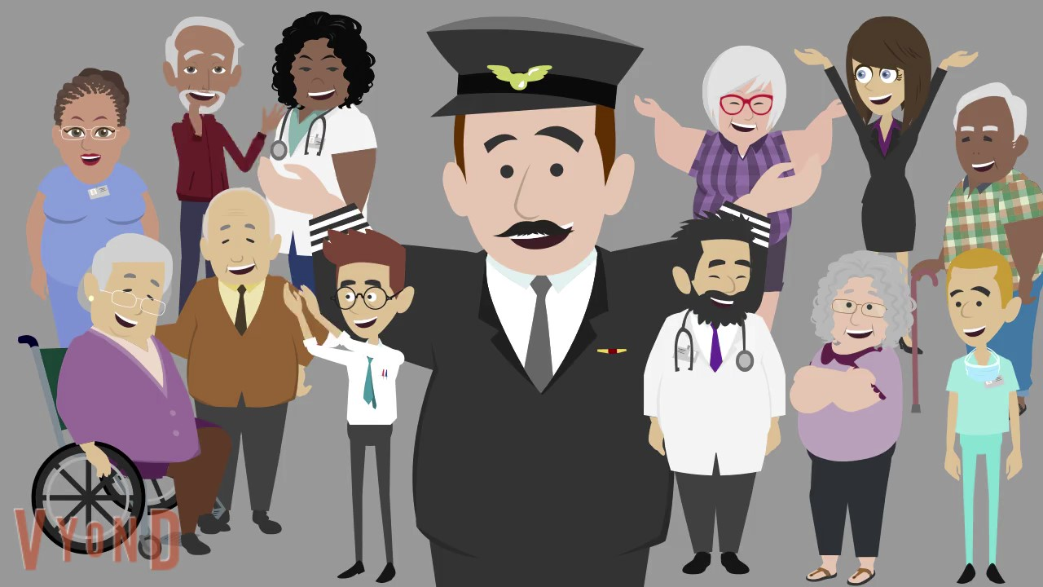
Our vision…
…is to co-design the future of older adults’ independent living.

Slide 11
Will you join us?
What the CAPTAIN community will:
Participate in meet-ups (every 2 months)
Interact with new technologies
Share ideas, concerns, visions
Join leisure & social activities
Notes:
Gamified activities : some activities that are implemented like games, are enjoyable for a person to participate

Slide 12
The consortium
Proud of my partners in this journey…
Coordinated by

Slide 13
Come join us in this…journey!

